Slide 1
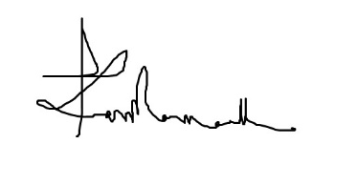
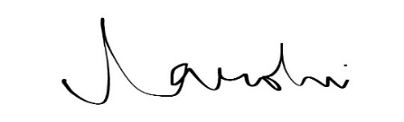
Learning & Development
Certificate of Completion
Darshan Sadashiva
Who has successfully completed the
OpenAi Codex Hackathon 2026
With all the rights, privileges and honors thereunto appertaining. Given this 5-Jun-26.
Hari Parameswaran
Global Delivery Head
ADM & DE
Thirumala Arohi
Chief Learning Officer,
Learning & Development​

